Slide 1
Hyperonomy Universal Decentralized Identifier URI Specification (did-uri-spec): “DID ABNF” Comparison and Coexistence https://github.com/mwherman2000/did-uri-spec
v0.22
Michael Herman (@mwherman2000)
Independent Blockchain Architect
mwherman@parallelspace.net

Slide 2
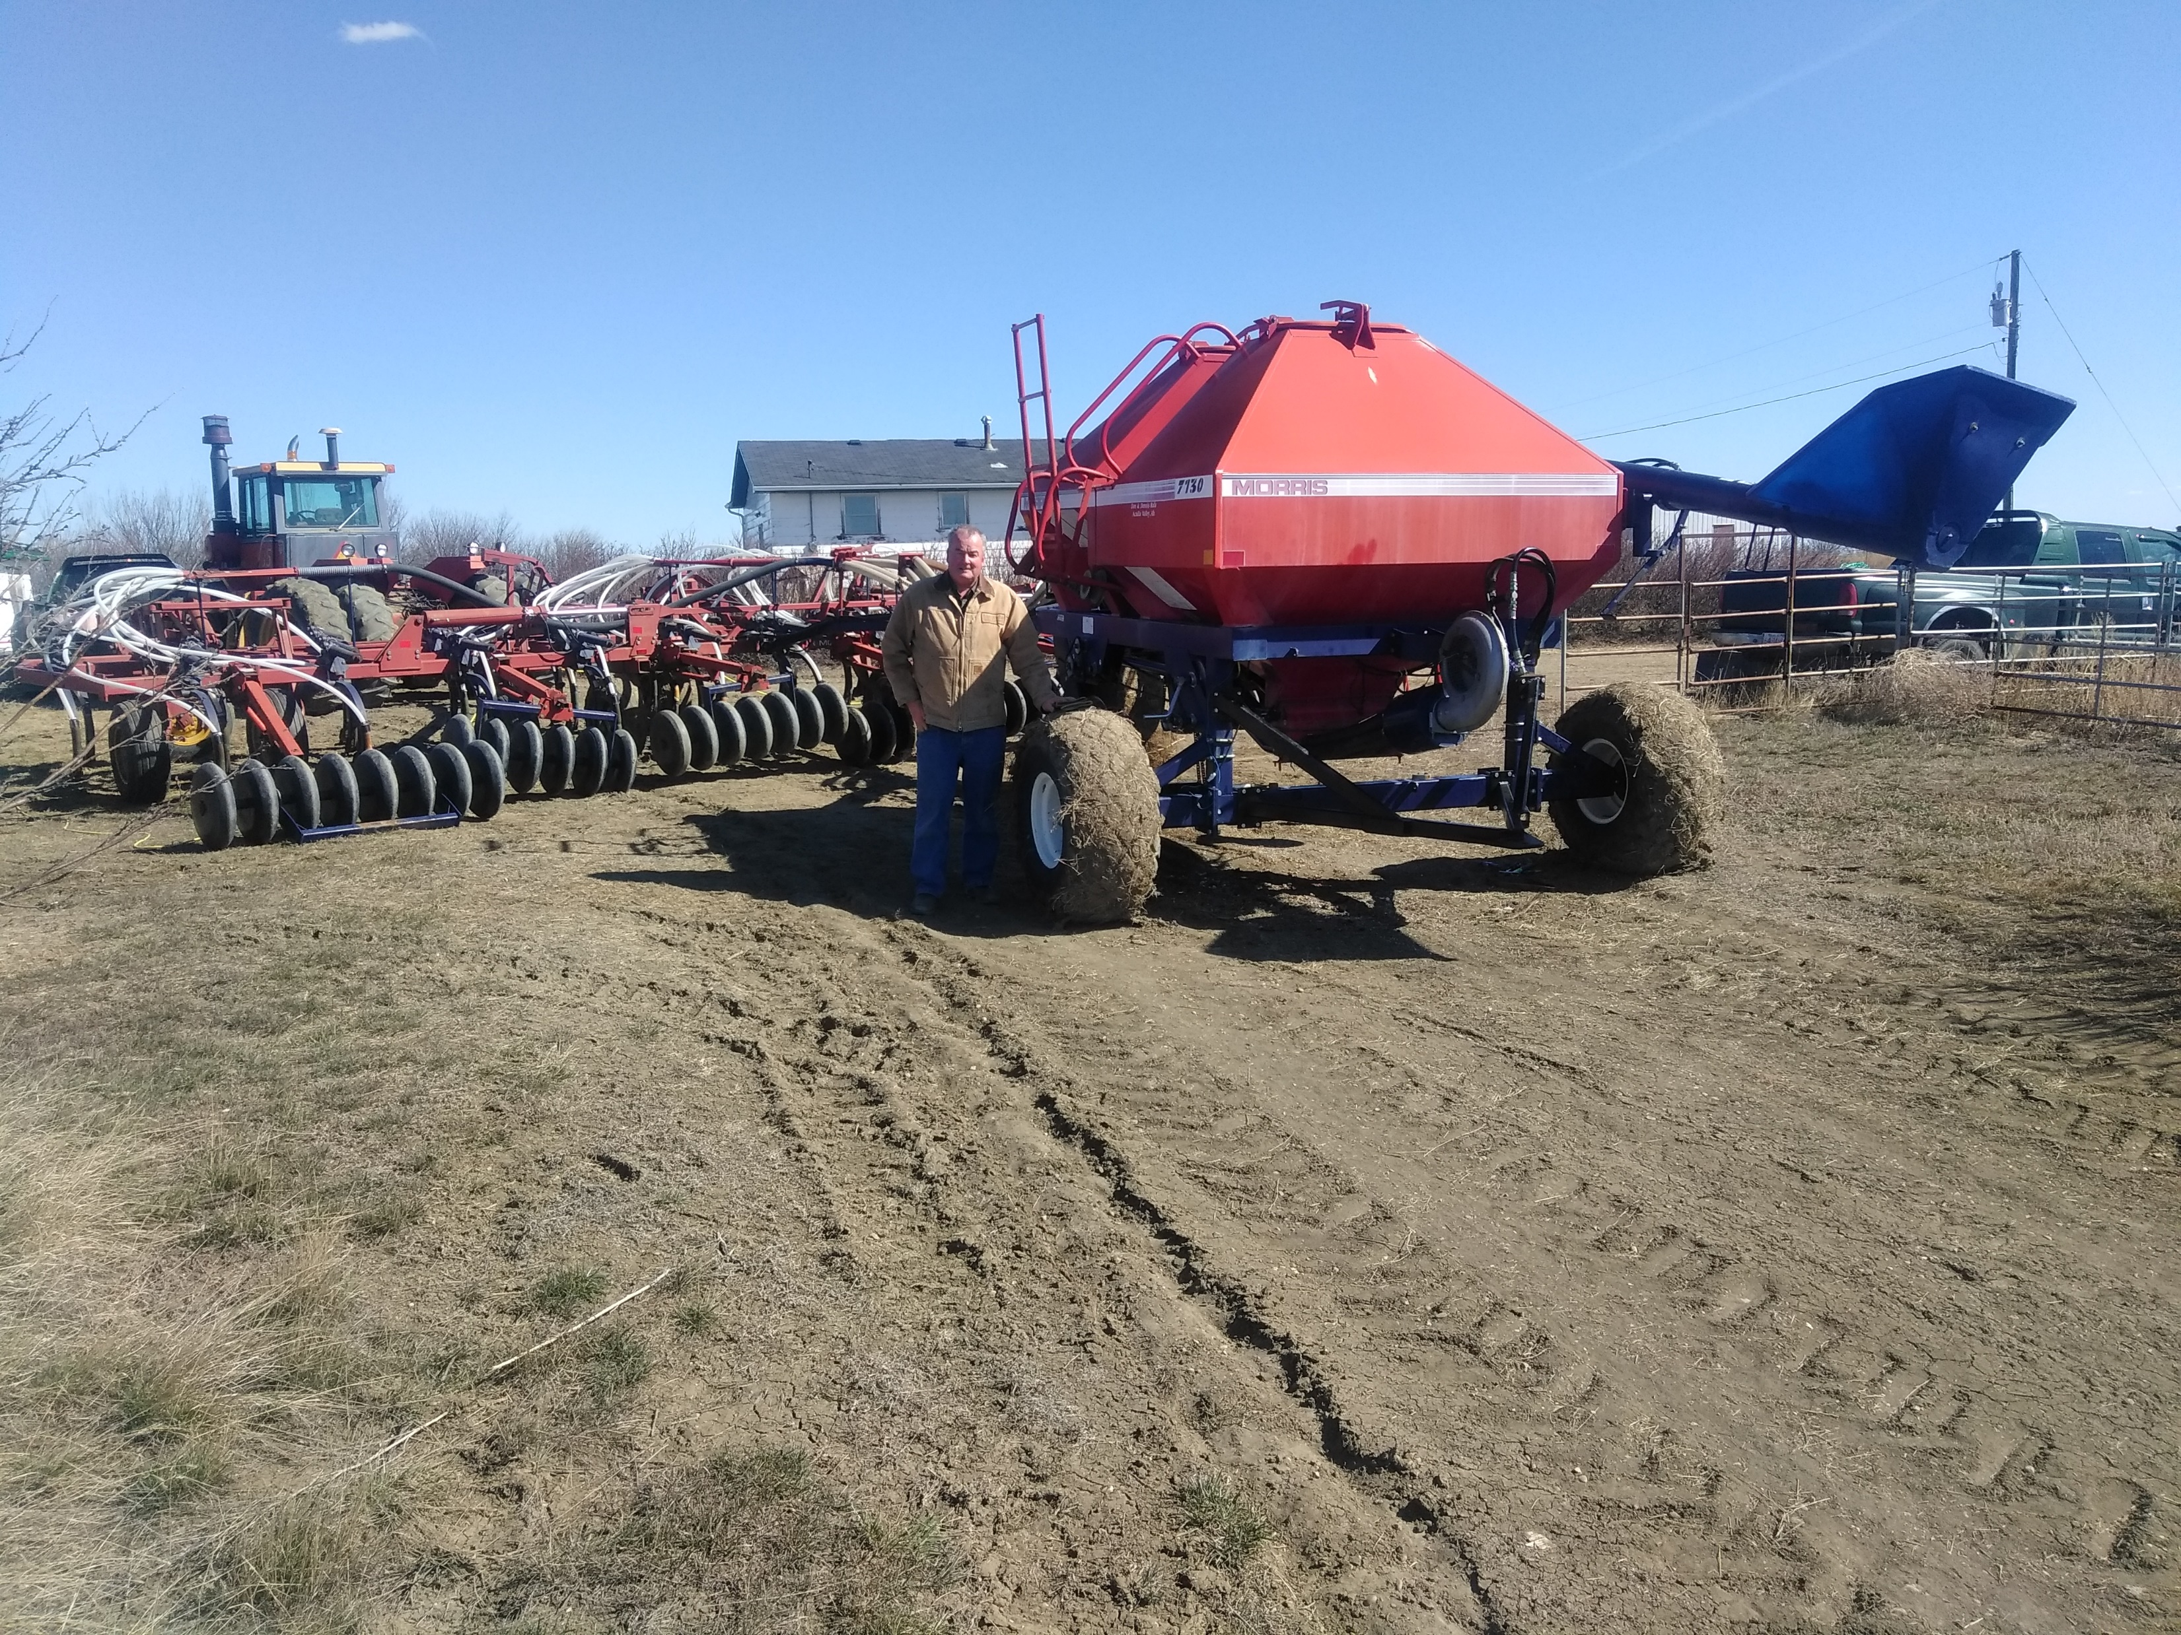
Michael Herman Independent Blockchain Architect Alberta, CANADA
POP QUIz how many (Distributed) Subsystems Can you identify in this Photo? HINT: There’s almost 40.
Notes:
My name is Michael Herman and I am an independent blockchain architect. I live on a ranch in Alberta, Canada and
I’ve worked on large, complex, distributed systems in hostile environments for more than 40 years.
Pop quiz: How many distributed subsystems do you see in this photo? Please email me your list to mwherman@parallelspace.net
Environment subsystems
Weather, soil nutrients and moisture (2)
Air seeder subsystems
Man-machine sensors, interfaces, alarms, gauges, steps ladders (multiple)
Hydraulic lift (hydraulic cylinders), hydraulic power (hydraulic motors) (2)
Mechanical systems: in-field soil depth, folding into the configuration for on-road transport, floating, multi-sectional structure, hitch (3)
Air flow: Seed distribution, fertilizer distribution (2)
Tires, wheels, hubs, axles, supports, casters (1)
Ground-driven drive (synchronized seed delivery with ground speed) (1)
Soil management (cultivation, seed delivery, packing) (2)
Lubrication (grease, oil) (1)
Tractor subsystems
Diesel power plant (engine, sensors, alarms, gauges, diesel injection, glow plugs) (4)
Cooling system (radiator, reservoir, hoses, sensors, alarms, gauges, coolant, temperature control values) (2)
Fuel system (tanks, hoses, sensors, alarms, gauges) (1)
Hydraulic systems (pumps, reservoirs, controls, hoses and lines, quick connectors, sensors, alarms, gauges) (4)
Engine air intake (stack, filters, sensors) (2)
Cab (ventilation/air conditioning, sound barriers, radios, man-machine interfaces, seats, door, windows, steps, controls, gauges) (4)
Tires, wheels, hubs, axles (1)
Lights and lighting (2)
Drawbar (1)
Lubrication (grease, oil) (1)

Slide 3
Purpose and Audience
Purpose
The purpose of this presentation is:
Compare and contrast the did-uri-spec grammar from the Hyperonomy Universal Decentralized Identifier URI specification (did-uri-spec) with the “DID ABNF” grammar from the Decentralized Identifiers specification
Document various technical strategies for the two DID grammars to co-exist and be used together
Audience
The primary audience for this presentation is implementors and maintainers of parser software that is compliant with the did-uri-spec including but not limited to:
W3C Decentralized Identifier specification
DID Resolvers and DID Resolution
Agent-to-Agent (A2A) Communications services in the Hyperledger Indy Agent framework

Slide 4
 Background / Executive Summary
Michael Herman (@mwherman2000)
Independent Blockchain Architect
mwherman@parallelspace.net
2019-04-01

Slide 5
Comparison: did-uri-spec & “DID ABNF” Grammars Examples / Executive Summary
<did>
<did>#exam_src
<did>;exam_src
<did>!pqrs
<did>
<did>!$selectId=“exam_src”
<did>!$serviceId=“exam_src”
<did>!$contentId=“pqrs”

Slide 6
 The Grammars
Michael Herman (@mwherman2000)
Independent Blockchain Architect
mwherman@parallelspace.net
2019-04-01

Slide 7
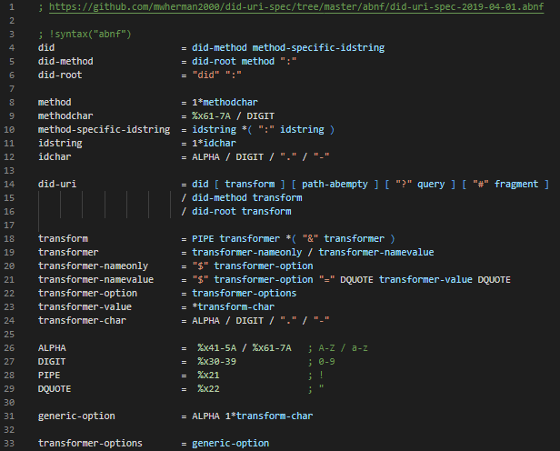

Generic/ Baseline did-uri-spec Grammar
RFC 3986
Compliant

Slide 8
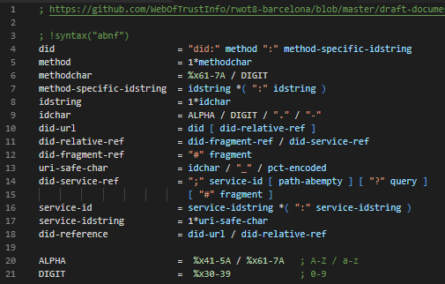
“DID ABNF” (BB) (Before Barcelona)

Slide 9
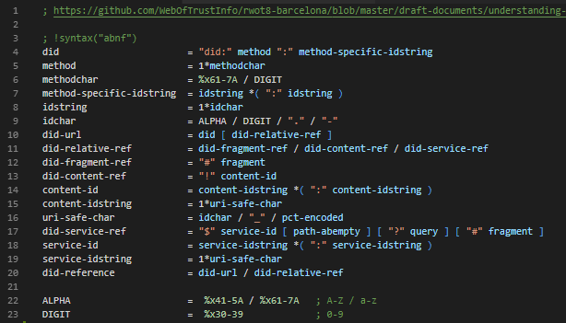
“DID ABNF” (AB) (After Barcelona)

Slide 10
 In-depth Comparisons
Michael Herman (@mwherman2000)
Independent Blockchain Architect
mwherman@parallelspace.net
2019-04-01

Slide 11
High-level did-uri-spec User Scenarios (Slide 45)
# | did-uri-spec Syntax Patterns | Type of Document Returned
1 | <did> | DID Document
2 | <did>!$selectId="exam_src" | DID Document Fragment
3 | <did>!$serviceId="exam_src" | Remapped Service Endpoint URI/URL
4 | <did>!$contentId="pqrs" | DID Doc Content Fragment
5* | <did>!$attachmentId="abcd" | A2A Message Attachment Fragment
6 | "query": "<did>!$filter='*'" | Array of All Service Agent Feature/Protocol Descriptions
7 | "query": "<did>!$filter='spec/tictactoe/1.*'" | Array of Filtered Service Agent Feature/Protocol Descriptions
8 | <didmethod>!$supportedCapabilities | Array of DID Method Capabilities
9a | did:!$documents / did:xyz:!$documents | Array of DID Documents
9b | did:xyz:!$documents&$top=10&$skip=100 | Batch of DID Documents
9c | did:xyz:!$documents&$filter='has=ServiceEndPoint'&$top=10&$skip=100
9d | did:xyz:!$documents&$filter='version=4'&$top=10&$skip=100
Notes:
* Makes false assumption that each Agent message has a `did` associated with it.

Slide 12
High-level did-uri User Scenarios (Slide 46)
# | did-uri Syntax Patterns | Type of Document Returned
10 | <did>!?$exists | True or False
11 | <did>!?$exists="bops" | True or False
12 | <did>!$type="diddoc" (default type – UC #1) | DID Document
13 | <did>!$type="schema" | Schema Document
14 | <did>!$type="creddef" | Credential Definition Document
15 | <did>!$type="overlay.format" | Format Overlay Document
16 | <did>!$type="node" | VDR Node Document
17 | did:!$type="config.pool" | Pool Configuration Document
18 | did:!$type="perfmon.pool" | Pool Performance Monitoring Doc
19 | did:xyz:!$type="perfmon.didmethod" | DID Method Perf. Monitoring Doc

Slide 13
High-level did-uri-spec Grammar
# | High-level did-uri-spec User Scenario | “DID ABNF" (BB) / (AB)
1 | <did>
2 | <did>!$selectId="exam_src"
3 | <did>!$serviceId="exam_src"
4 | <did>!$contentId="pqrs"
did-uri = did [ transform ] [ path-abempty ] [ "?" query ] [ "#" fragment ]
transform = PIPE transformer *( "&" transformer )
transformer = transformer-nameonly / transformer-namevalue
transformer-nameonly = "$" transformer-option
transformer-namevalue = "$" transformer-option "=" DQUOTE transformer-value DQUOTE
transformer-option = transformer-options
transformer-options = generic-option
generic-option = ALPHA 1*transform-char
Notes:
* Makes false assumption that each Agent message has a `did` associated with it.

Slide 14
“DID ABNF" (BB) / (AB)
# | High-level did-uri-spec User Scenario | “DID ABNF" (BB) / (AB)
1 | <did> | <did>
2 | <did>!$selectId="exam_src"
3 | <did>!$serviceId="exam_src"
4 | <did>!$contentId="pqrs"
Notes:
* Makes false assumption that each Agent message has a `did` associated with it.

Slide 15
“DID ABNF" (BB) / (AB)
# | High-level did-uri-spec User Scenario | “DID ABNF" (BB) / (AB)
1 | <did> | <did>
2 | <did>!$selectId="exam_src" | <did>#exam_src
3 | <did>!$serviceId="exam_src"
4 | <did>!$contentId="pqrs"
Notes:
* Makes false assumption that each Agent message has a `did` associated with it.

Slide 16
“DID ABNF" (BB) / (AB)
# | High-level did-uri-spec User Scenario | “DID ABNF" (BB) / (AB)
1 | <did> | <did>
2 | <did>!$selectId="exam_src" | <did>#exam_src
3 | <did>!$serviceId="exam_src" | <did>;exam_src
4 | <did>!$contentId="pqrs"
Notes:
* Makes false assumption that each Agent message has a `did` associated with it.

Slide 17
“DID ABNF" (BB) / (AB)
# | High-level did-uri-spec User Scenario | “DID ABNF" (BB) / (AB)
1 | <did> | <did>
2 | <did>!$selectId="exam_src" | <did>#exam_src
3 | <did>!$serviceId="exam_src" | <did>;exam_src
4 | <did>!$contentId="pqrs" | <did>!pqrs
Notes:
* Makes false assumption that each Agent message has a `did` associated with it.

Slide 18
“DID ABNF" (BB) / (AB)
# | High-level did-uri-spec User Scenario | “DID ABNF" (BB) / (AB)
1 | <did> | <did>
2 | <did>!$selectId="exam_src" | <did>#exam_src
3 | <did>!$serviceId="exam_src" | <did>;exam_src
4 | <did>!$contentId="pqrs" | <did>!pqrs
did-url = did [ did-relative-ref ]
did-relative-ref = did-fragment-ref / did-content-ref / did-service-ref
did-fragment-ref = "#" fragment
did-content-ref = "!" content-id
content-id = content-idstring *( ":" content-idstring )
content-idstring = 1*uri-safe-char
uri-safe-char = idchar / "_" / pct-encoded
did-service-ref = "$" service-id [path-abempty] ["?" query] ["#" fragment]
Notes:
* Makes false assumption that each Agent message has a `did` associated with it.

Slide 19
 Feature/Capability Comparison
Michael Herman (@mwherman2000)
Independent Blockchain Architect
mwherman@parallelspace.net
2019-04-01

Slide 20
Comparison: did-uri-spec & “DID ABNF” Grammars
 | Generic did-uri-spec Grammar | “DID ABNF" (BB) / (AB)
Extensibility
#OpenToInnovation Principle Domain-Specific DID Grammar Support Co-existence with alternative DID grammars | ✓ ✓ ✓ | ✗ ✗ ✗
Supported Specifications
DID Documents DID Document Collections Indy Protocol Discovery Indy Message Attachments | ✓ ✓ ✓ ✓ | ✓ ✗ ✗ ✗
RFC 3986
RFC 3986 Compliant | ✓ | TBD
Dereferencing
Server-side Client-side | ✓ ✓ | ✗ ✓
Notes:
* Makes false assumption that each Agent message has a `did` associated with it.

Slide 21
 Co-Existence and Native Support
Michael Herman (@mwherman2000)
Independent Blockchain Architect
mwherman@parallelspace.net
2019-04-01

Slide 22
Parsing and Processing Pipeline did-uri-spec Scenarios
did-uri
Parser
Analyser
Optimizer (VDR)
Execution Engine (VDR)
Verifiable Data Registry
did-uri
Parser
Analyser
Optimizer (AFDB)
Execution Engine (AFDB)
Indy Agent Feature DB
did-uri*
Parser
Analyser
Optimizer (JSON)
Execution Engine (JSON)
Indy Agent
Message Attachment
Collection
did-uri
-
-
-
-
id
Attribute

Slide 23
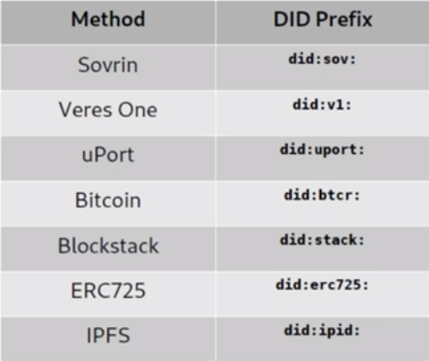
common DID Methods and Schemes
DID Method
DID Scheme

Slide 24
CO-Existence: Using Universal did Resolver DRIVERS
did-uri
Parser
Analyser
Optimizer (did-uri AST)
Execution Engine (did:sov)
did:sov
VDR Driver
Execution Engine (did:bctr)
did:bctr VDR Driver
Execution Engine (did:erc375)
did:erc375
VDR Driver
Execution Engine (did:ipid)
did:ipid VDR Driver

Slide 25
NATIVE SUPPORT: Using Native Data Store Interfaces
did-uri
Parser
Analyser
Optimizer (did-uri AST)
Execution Engine
(did-uri AST)
did:sov
VDR API
did:bctr VDR API
did:erc375
VDR API
did:ipid VDR API

Slide 26
 Wrapping UP…
Michael Herman (@mwherman2000)
Independent Blockchain Architect
mwherman@parallelspace.net
2019-04-01

Slide 27
Next Steps
Continue to grow and validate the number of higher-level DID user scenarios and, more specifically, lower-level did-uri-spec use cases with:
Diverse DID communities
Diverse DID higher-level DID user scenarios
More Indy HIPES
IPID, etc.
Build and test did-uri grammar
Using the lower-level did-uri-spec use cases as a test cases
Continue to grow the outreach (awareness, knowledge and understanding) of the did-uri-spec specification amongst:
Diverse DID communities
Diverse DID higher-level DID user scenario specific scenarios
More Indy HIPES
IPID, etc.

Slide 28
Michael Herman Independent Blockchain Architect Alberta, CANADA
POP QUIz how many (Distributed) Subsystems Can you identify in this Photo? HINT: There’s almost 40.
Notes:
My name is Michael Herman and I am an independent blockchain architect. I live on a ranch in Alberta, Canada and
I’ve worked on large, complex, distributed systems in hostile environments for more than 40 years.
Pop quiz: How many distributed subsystems do you see in this photo? Please email me your list to mwherman@parallelspace.net
Environment subsystems
Weather, soil nutrients and moisture (2)
Air seeder subsystems
Man-machine sensors, interfaces, alarms, gauges, steps ladders (multiple)
Hydraulic lift (hydraulic cylinders), hydraulic power (hydraulic motors) (2)
Mechanical systems: in-field soil depth, folding into the configuration for on-road transport, floating, multi-sectional structure, hitch (3)
Air flow: Seed distribution, fertilizer distribution (2)
Tires, wheels, hubs, axles, supports, casters (1)
Ground-driven drive (synchronized seed delivery with ground speed) (1)
Soil management (cultivation, seed delivery, packing) (2)
Lubrication (grease, oil) (1)
Tractor subsystems
Diesel power plant (engine, sensors, alarms, gauges, diesel injection, glow plugs) (4)
Cooling system (radiator, reservoir, hoses, sensors, alarms, gauges, coolant, temperature control values) (2)
Fuel system (tanks, hoses, sensors, alarms, gauges) (1)
Hydraulic systems (pumps, reservoirs, controls, hoses and lines, quick connectors, sensors, alarms, gauges) (4)
Engine air intake (stack, filters, sensors) (2)
Cab (ventilation/air conditioning, sound barriers, radios, man-machine interfaces, seats, door, windows, steps, controls, gauges) (4)
Tires, wheels, hubs, axles (1)
Lights and lighting (2)
Drawbar (1)
Lubrication (grease, oil) (1)

Slide 29
Pop quiz: How many (distributed) subsystems CAN you see in this photo? (1/3)
Air Seeder Subsystems
Man-machine sensors, interfaces, alarms, gauges, steps ladders (multiple)
Hydraulic lift (hydraulic cylinders), hydraulic power (hydraulic motors) (2)
Mechanical systems: in-field soil depth, folding into the configuration for on-road transport, floating, multi-sectional structure, hitch (3)
Air flow: Seed distribution, fertilizer distribution (2)
Tires, wheels, hubs, axles, supports, casters (1)
Ground-driven drive (synchronized seed delivery with ground speed) (1)
Soil management (cultivation, seed delivery, packing) (2)
Lubrication (grease, oil) (1)

Slide 30
Pop quiz: How many (distributed) subsystems CAN you see in this photo? (2/3)
Tractor Subsystems
Diesel power plant (engine, sensors, alarms, gauges, diesel injection, glow plugs) (4)
Cooling system (radiator, reservoir, hoses, sensors, alarms, gauges, coolant, temperature control values) (2)
Fuel system (tanks, hoses, sensors, alarms, gauges) (1)
Hydraulic systems (pumps, reservoirs, controls, hoses and lines, quick connectors, sensors, alarms, gauges) (4)
Engine air intake (stack, filters, sensors) (2)
Cab (ventilation/air conditioning, sound barriers, radios, man-machine interfaces, seats, door, windows, steps, controls, gauges) (4)
Tires, wheels, hubs, axles (1)
Lights and lighting (2)
Drawbar (1)
Lubrication (grease, oil) (1)

Slide 31
Pop quiz: How many (distributed) subsystems CAN you see in this photo? (3/3)
Environment Subsystems
Weather (1)
Soil nutrients and moisture (1)

Slide 32
 QUESTIONS?
Michael Herman (@mwherman2000)
Independent Blockchain Architect
mwherman@parallelspace.net
2019-04-01

Slide 33
Hyperonomy Universal Decentralized Identifier URI Specification (did-uri-spec)
2019-04-01

